Slide 1
Module-6 Inheritance

Slide 2
Inheritance
To inherit the members of an existing class.
This existing class is called the base class, and the new class is referred to as the derived class.
To reuse the code functionality and fast implementation time.
NOTE: All members of a class except Private, are inherited

Slide 3
Syntax
class Subclass_name : access_mode Superclass_name
Access Mode is used to specify, the mode in which the properties of superclass will be inherited into subclass, public, privtate or protected.

Slide 4
Access Specifiers
In C++, there are three access specifiers:
public - members are accessible from outside the class. It can be accessed from anywhere in the program using the direct member access operator (.) with the object of that class. [b.x etc..]
private - members cannot be accessed (or viewed) from outside the class. The class members declared as private can be accessed only by the member functions inside the class.
protected - members cannot be accessed from outside the class, however, they can be accessed in inherited classes.

Slide 5
EXAMPLE
class Animal // base class
{
public:
int legs = 4;
};
class Dog : public Animal // derived class
{
public:
int tail = 1;
};
int main()
{
Dog d;
cout << d.legs;
cout << d.tail;
}

Slide 6
Inheritance
A derived class inherits all base class methods with the following exceptions:
Constructors, destructors and copy constructors of the base class.
Overloaded operators of the base class.
The friend functions of the base class

Slide 7

Mode of Inheritance
Public: visible to everyone
Protected: visible to the current class and the derived class
Private: visible to current class only
#include<iostream>
using namespace std;
class base {
public:
int x;
};
class derived: public base{
};
int main()
{
return 0;
}
Mode of Inheritance

Slide 8
Inheritance mode
Inheritance mode → | Private mode | Protected mode | Public mode
Base class ↓ | Data members in Derived class will become as:
private | Not inherited | Not inherited | Not inherited
protected | private | protected | protected
public | private | Protected | public

Slide 9
Friend class can inherit public , protected , as well as private inside function but only through object
In inheritace only public , protected can be accessed inside function but with or without object.

Slide 10
#include<iostream>
using namespace std;
class base {
public:
int x;
};
class derived: public base{
};
int main()
{
derived d;
cout<<"x = "<<d.x<<endl;
return 0;
}
Output:
x = 0

Slide 11
#include<iostream>
using namespace std;
class base {
public:
int x;
};
class derived: public base{
public:
void print()
{
cout<<"x2 = "<<x<<endl;
}
};
int main()
{
derived d;
cout<<"x1 = "<<d.x<<endl;
d.print();
return 0;
}
Output:
x1 = 0
x2 = 0

Slide 12
Inheritance: Example
#include<iostream>
using namespace std;
class animal {
public:
void eat() {cout<<"Eating..."<<endl;
}
void walk() {cout<<"Walking..."<<endl;
}
};
class dog: public animal{
public:
void talk(){cout<<"Bark.."<<endl;
}
};
class cat: public animal{
public:
void talk(){cout<<"Meow.."<<endl;
}
};
class tiger: public animal{
public:
void talk(){cout<<"Roar.."<<endl;
}
};
int main()
{
dog d;
cat c;
tiger t;
d.eat();
c.eat();
t.eat();
return 0;
}
Output:
Eating..
Eating..
Eating..

Slide 13
Types of inheritance
Single Inheritance
Multiple Inheritance
Hierarchical Inheritance
Multilevel Inheritance
Hybrid Inheritance
Multipath Inheritance

Slide 14
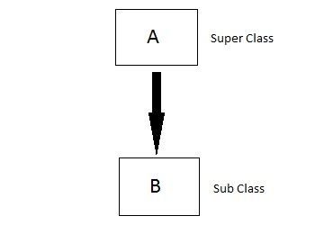
Single inheritance
In this type of inheritance one derived class inherits from only one base class.
It is the simplest form of Inheritance.
This is a “is a” relationship
E.g.: car is a vehicle

Slide 15
Example
class Shape
{
protected:
float width, height;
public:
void set_data (float a, float b)
{
width = a;
height = b;
}
};
class Rectangle: public Shape
{
public:
float area ()
{
return (width * height);
}
};
int main ()
{
Rectangle rect;
rect.set_data (5,3);
cout << rect.area() << endl;
return 0;
}

Slide 16
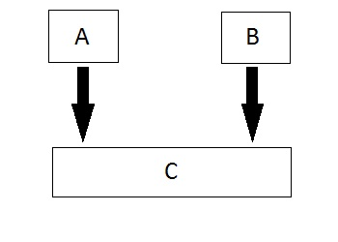
Multiple Inheritance
In this type of inheritance a single derived class may inherit from two or more than two base classes.
Reverse is not possible, means C can inherit from A and B, but reverse is not possible
Order of A and B will remain same in the order they are inherited

Slide 17
Example
class student
{
protected:
int rno,m1,m2;
public:
void get()
{
cout<<"Enter the Roll no :";
cin>>rno;
cout<<"Enter the two marks :";
cin>>m1>>m2;
}
};
class sports
{
protected:
int sm; // sm = Sports mark
public:
void getsm()
{
cout<<"\nEnter the sports mark :";
cin>>sm;
}
};
class statement:public student, public sports
{
int tot,avg;
public:
void display()
{
tot=(m1+m2+sm);
avg=tot/3;
cout<<"\n\n\tRoll No : "<<rno<<"\n\tTotal : "<<tot;
cout<<"\n\tAverage : "<<avg;
}
};
void main()
{
clrscr();
statement obj;
obj.get();
obj.getsm();
obj.display();
getch();
}

Slide 18
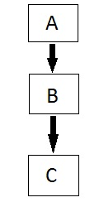
Multilevel Inheritance
In this type of inheritance the derived class inherits from a class, which in turn inherits from some other class. The Super class for one, is sub class for the other.
The hierarchy is important in this.

Slide 19
example
class A
{
public:
void display()
{
cout<<"Base class content.";
}
};
class B : public A
{
};
class C : public B
{
};
int main()
{
C c;
c.display();
return 0;
}
Output:
Base class content.

Slide 20
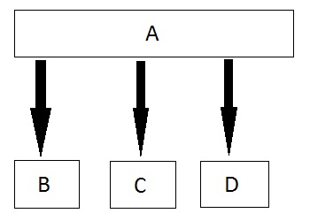
Hierarchical Inheritance
In this type of inheritance, multiple derived classes inherits from a single base class.

Slide 21
example
class A //Base Class
{
public:
int a,b;
void getnumber()
{
cout<<"\n\nEnter Number :::\t";
cin>>a;
}
};
class B : public A //Derived Class 1
{
public:
void square()
{
getnumber(); //Call Base class property
cout<<"\n\n\tSquare of the number :\t"<<(a*a);
}
};
class C :public A //Derived Class 2
{
public:
void cube()
{
getnumber(); //Call Base class property
cout<<"\n\n\t Cube of the number :::\t"<<(a*a*a);
}
};
int main()
{
B b1; //b1 is object of Derived class 1
b1.square(); //call member function of class B
C c1; //c1 is object of Derived class 2
c1.cube(); //call member function of class C
getch();
}

Slide 22
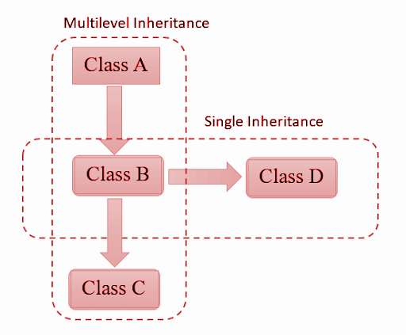
Hybrid Inheritance
Hybrid Inheritance is combination of Hierarchical and Multiple Inheritance or simple inheritance.

Slide 23
example
class arithmetic
{
protected:
int num1, num2;
public:
void getdata()
{
cout<<"For Addition:";
cout<<"\nEnter the first number: ";
cin>>num1;
cout<<"\nEnter the second number: ";
cin>>num2;
}
};
class minus
{
protected:
int n1,n2,diff;
public:
void sub()
{
cout<<"\nFor Subtraction:";
cout<<"\nEnter the first number: ";
cin>>n1;
cout<<"\nEnter the second number: ";
cin>>n2;
diff=n1-n2;
}
};
class result:public plus, public minus
{
public:
void display()
{
cout<<sum;
cout<<diff;
}
};
int main()
{
result z;
z.getdata();
z.add();
z.sub();
z.display();
return 0;
}
class plus:public arithmetic
{
protected:
int sum;
public:
void add()
{
sum=num1+num2;
}
};
Arith
Mns
plus
reslt

Slide 24
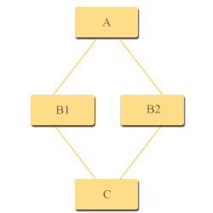
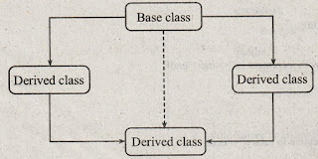
Multipath Inheritance
A derived class with two base classes and these two base classes have one common base class is called multipath inheritance.
First part is hierarchical inheritance and the 2nd part is multiple inheritance
A is inherited in C by two paths

Slide 25
Multipath Inheritance
This is the object layout of C.
A is inherited in C by two paths. This is a problem.
The solution is to inherit A in B1 directly and B2 virtually.
For this, we use the keyword virtual.
If we inherit A virtually in B1 and B2, A will appear in C only once.
Otherwise it will give an error of ambiguous access
A
B1
A
B2
C

Slide 26
Multipath Inheritance
Multipath inheritance may lead to duplication of inherited members from a grandparent base class. This may be avoided by making the common base class a virtual base class. When a class is made a virtual base class, C++ takes necessary care to see that only one copy of that class is inherited

Slide 27
EXAMPLE
class A
{
.....
};
class B1 : virtual public A
{
.....
};
class B2 : virtual public A
{
.....
};
class C : public B1, public B2
{
.....// only one copy of A
.....// will be inherited
};

